Slide 1
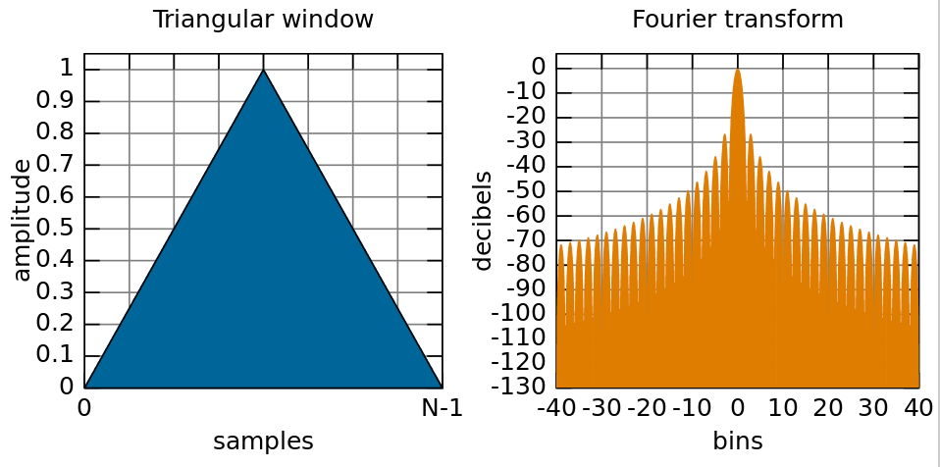
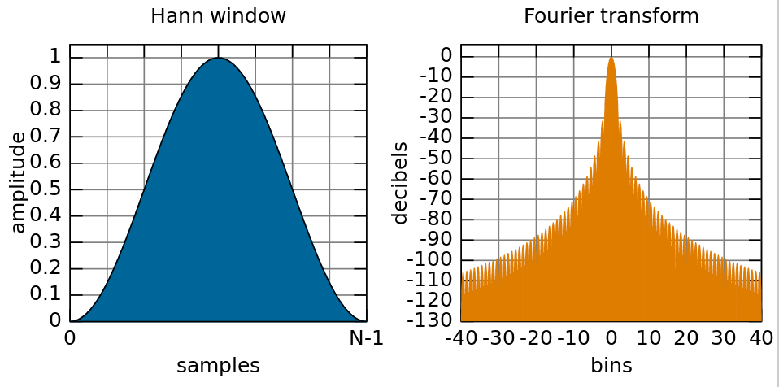
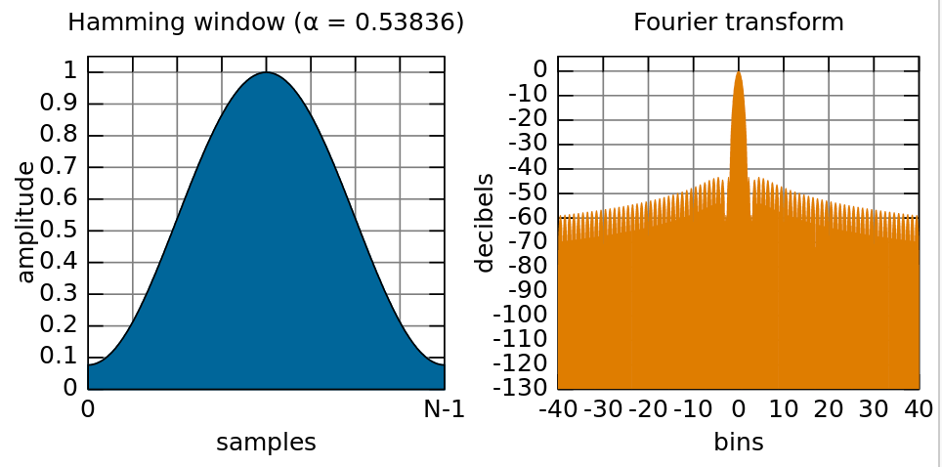
Phase vocoder, part 2
Look at working in frequency domain
Window functions
Constant Overlap-Add (COLA) criterion
Analysis and synthesis windows
Reconstructing exact frequency from FFT bin phase
FFT-based frequency detector

Slide 2
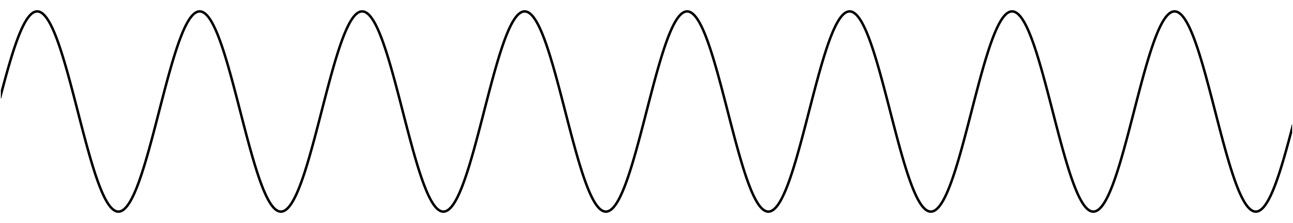
FFT of sine wave
Suppose its frequency exactly matches a bin: 2πk/N for some k
So integer number of oscillations in window
...
x[n]
All energy in one frequency bin
All other bins 0 (except mirror image above Nyquist)
Constant magnitude no matter where window starts
Phase may change depending on window location
Xk
(lower half)

Slide 3
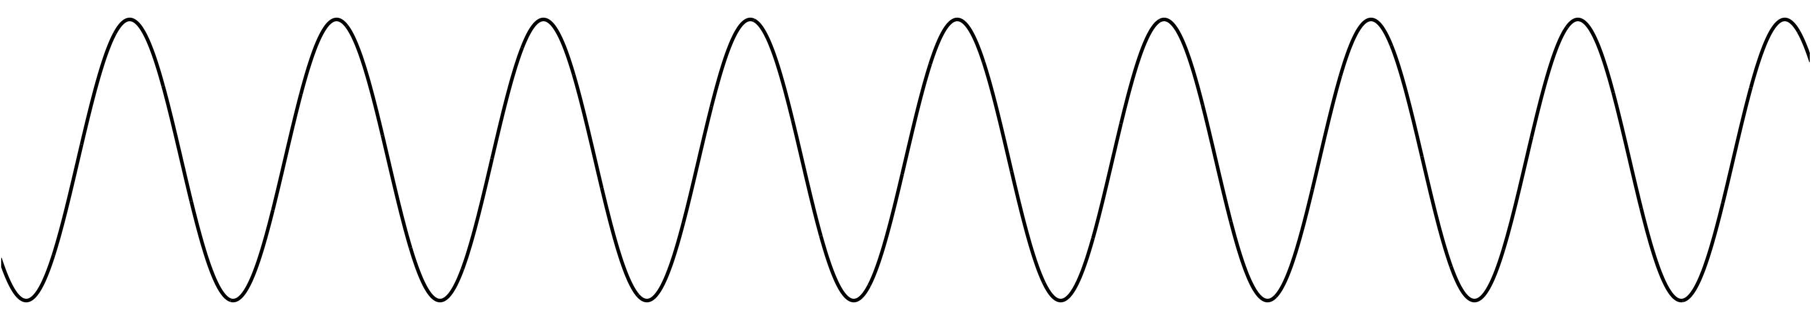
FFT of sine wave
If frequency doesn’t exactly match any bin
Energy smears out across all other frequency bins
Phase likely to be different on each successive hop
Usually, can reconstruct exact frequency based on phase changes!
x[n]
Non-integer number
of periods
Xk
Energy spills over into
other bins, especially close neighbours
(lower half)

Slide 4

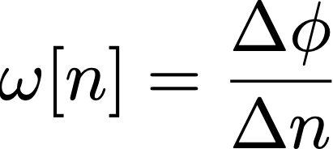
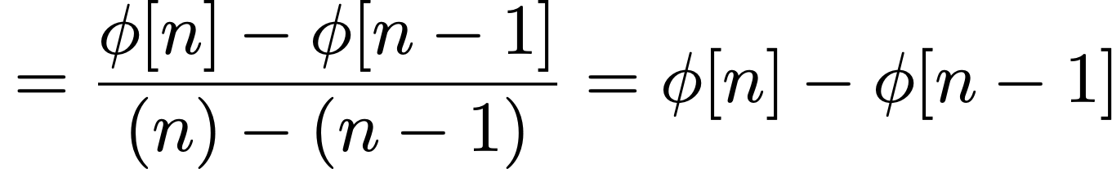
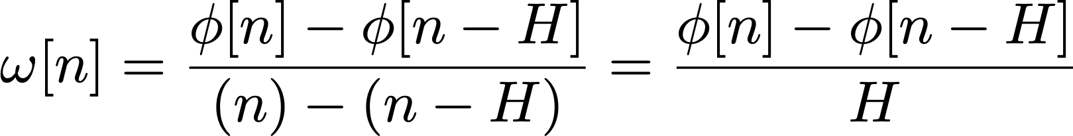
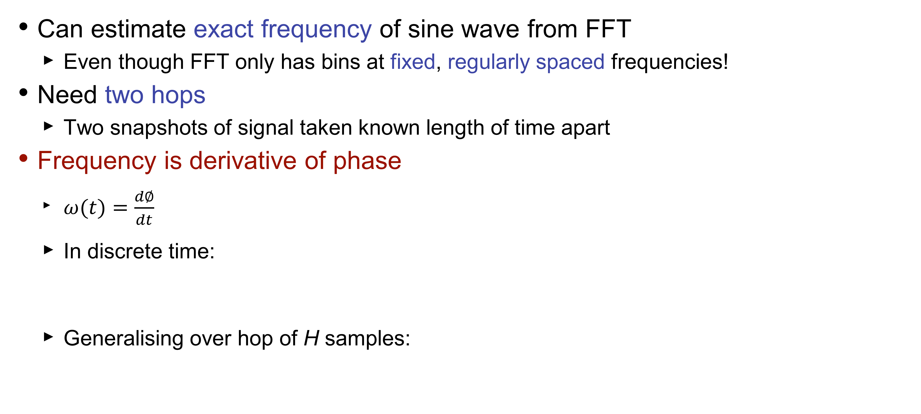
Reconstructing exact frequency
Can estimate exact frequency of sine wave from FFT
Even though FFT only has bins at fixed, regularly spaced frequencies!
Need two hops
Two snapshots of signal taken known length of time apart
Frequency is derivative of phase
$ω(t)=\frac{d∅}{dt}$
In discrete time:
Generalising over hop of H samples:
y

Slide 5
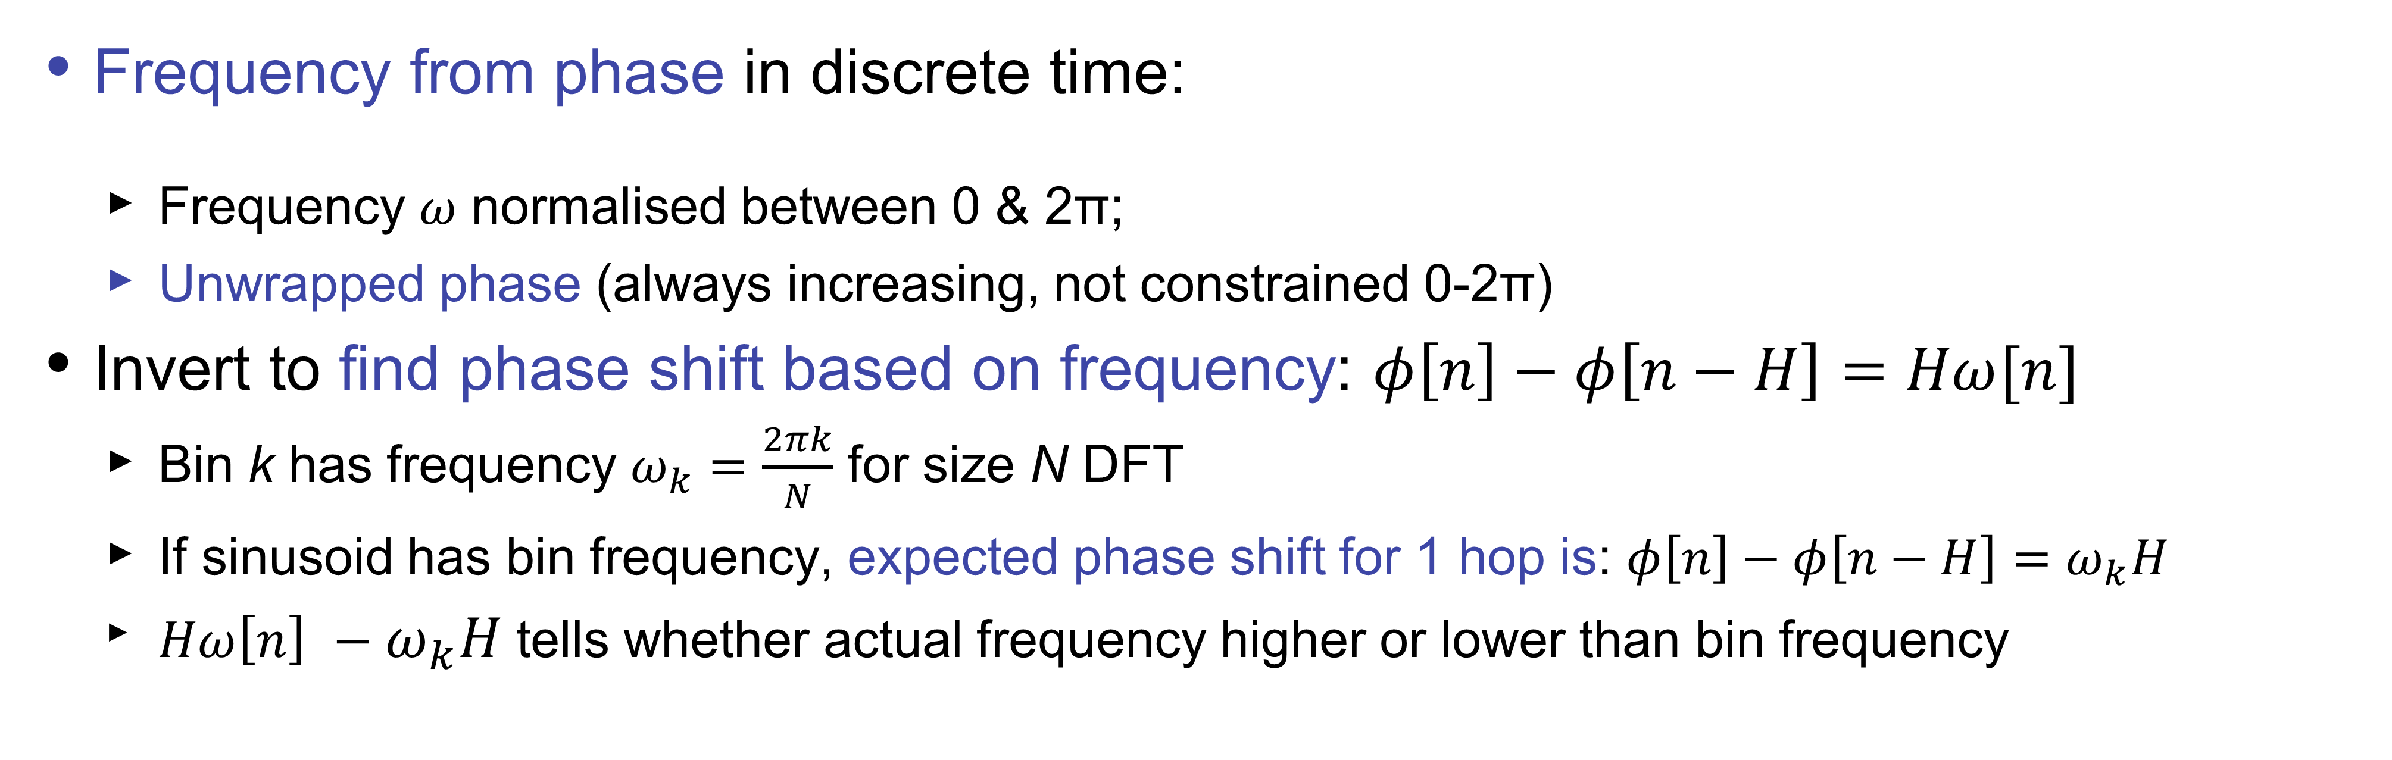
Reconstructing exact frequency
Frequency from phase in discrete time:
Frequency 𝜔 normalised between 0 & 2π;
Unwrapped phase (always increasing, not constrained 0-2π)
Invert to find phase shift based on frequency: $φ\left[n\right]−φ\left[n−H\right]=Hω[n]$
Bin k has frequency $ω_{k}=\frac{2πk}{N}$ for size N DFT
If sinusoid has bin frequency, expected phase shift for 1 hop is: $φ\left[n\right]−φ\left[n−H\right]=ω_{k}H$
${Hω\left[n\right] −ω}_{k}H$tells whether actual frequency higher or lower than bin frequency
φ[n]
Instantaneous frequency represented by gradient of dashed line
Bin frequency is gradient of solid line.
Φ_{e} – expected phase
Φ_{r} –phase deviation
Phase
φ_{r}
φ_{e}[n]
ω_{k}H
φ[n-H]
k-1
Frequency bin
k

Slide 6
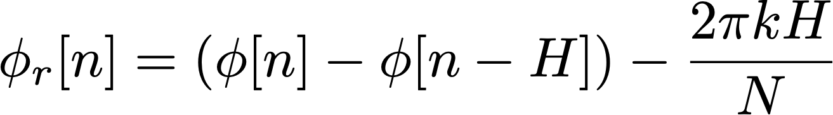
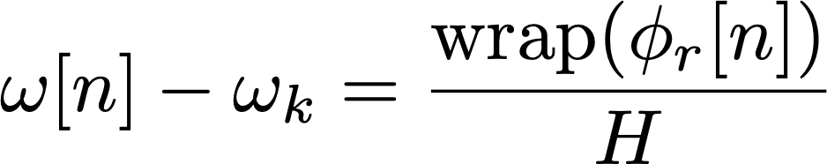
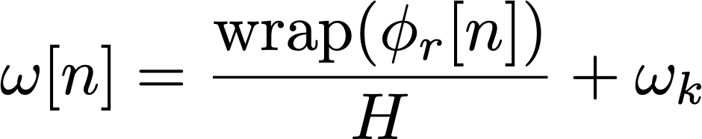
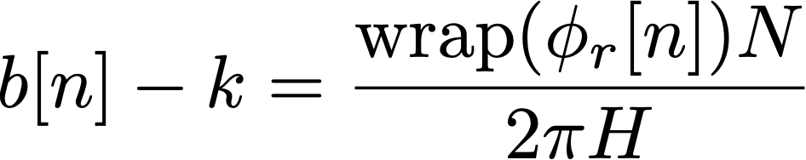
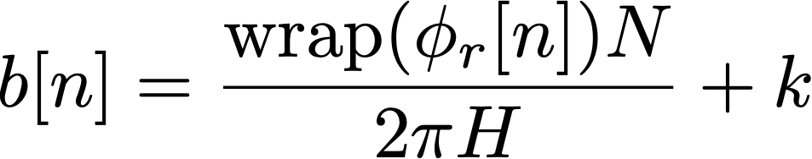
Reconstructing exact frequency
First calculate phase remainder:
Use remainder to calculate deviation from bin centre frequency:
Should wrap phase to be between -π and π (i.e. principal argument)
Finally, rearrange to get exact frequency of our sine wave:
Could also calculate in terms of (fractional) FFT bins
Use fact that bins are spaced 2π/N apart in frequency
measured phase values from bin k on two successive hops
centre frequency of bin k
multiplied by hop size
centre frequency of bin k (= 2πk/N)
fractional bin #
of sine wave

Slide 7
Reconstructing exact frequency: code
Predict how far phase ought to advance from one
hop to next, then compare actual measured values
Phase advancing farther means higher frequency (compared to bin frequency)
Phase advancing less far means lower frequency
What do we need to implement this in code?
Global (or static) variable to hold phase of each bin
Saving each bin implies an array
Similar to saving previous values of x[n] or y[n] for a filter
Function to wrap phase to range -π to π
Implement calculations inside our process_fft() function
Write for() loop iterating across each bin
y
prediction

Slide 8
Reconstructing exact frequency: task
Task: Write code to work out exact frequency of each bin
Implement these formulas:
You will need global or static array to hold previous phases
Same formula can apply to every bin regardless of magnitude
In practice, we only look at the first half of bins because the DFT is conjugate symmetric
hop size
bin phase this hop
bin phase last hop
FFT
size
bin
number
wrapPhase()
written for you
bin centre frequency
(2πk/N)

Slide 9
Choosing an FFT size
Previous formulas gave us one frequency component for each bin
FFT of size N has (N/2+1) unique bins after accounting for symmetry
Tells us maximum number of frequency components we can represent
N time-domain samples ↔︎ N frequency-domain bins
Larger FFT → greater frequency resolution
Bins spaced more closely together in frequency: 2πk/N
Easier to resolve two closely-spaced frequency components of signal
Trade off:
Fundamental mathematical limitations
Resolving short transient events within long time window is difficult
Poor time resolution, long latency

Slide 10
Choosing a hop size
How often should we take FFT?
If we want to reconstruct signal, hop size H must be no more than FFT size N
Advantages of smaller hop sizes
More frequent time snapshots of signal
Phase of each bin advances less from one hop to next,
improving frequency estimation
Some types of window need a hop size of N/2, N/3 or even less to reconstruct the signal
Lower latency for phase vocoder effects
Disadvantages of smaller hop sizes
More computationally expensive
Hop sizes that aren’t integer division of FFT size can lead to reconstruction artifacts
H = N
H = N/2
H = N/4

Slide 11
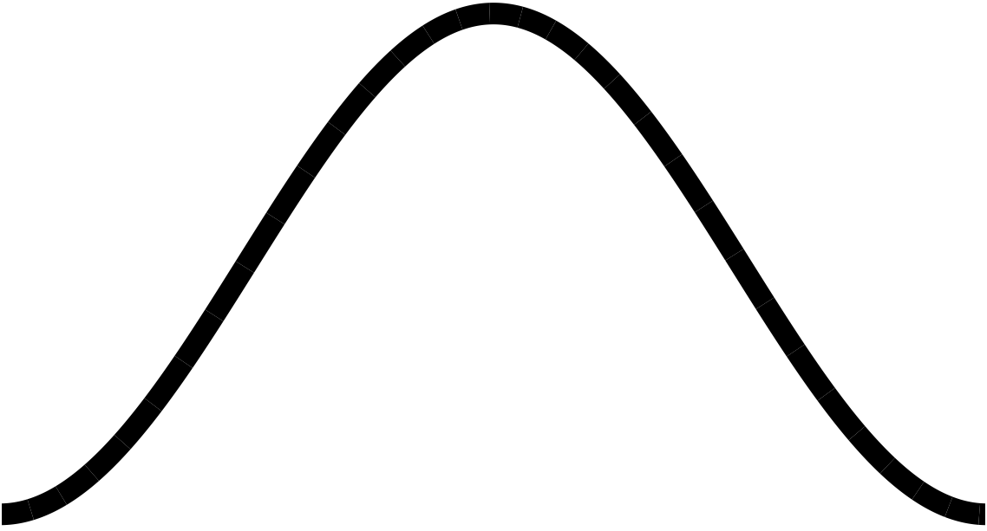
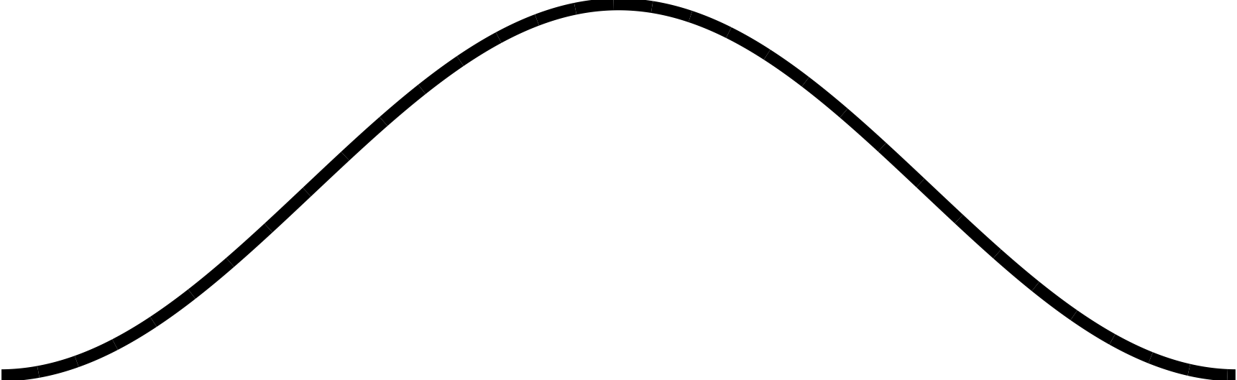
Windowing
Overlap-Add process segments signal into finite-length windows
These segments can have discontinuities at the edges (assuming 0 outside the window)
Might not notice this if we just reconstruct the signal with no frequency-domain processing
If we modify signal, these sharp edges can lead to crackling or buzzing sounds
Can use window function to taper the edges
Pre-calculated shape that we multiply the segment by before FFT
H = N/4
sharp edges
Hann window

Slide 12
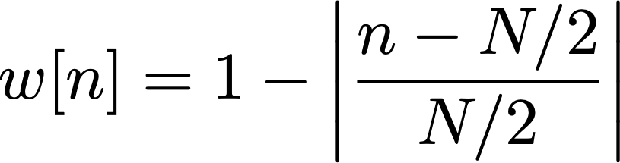


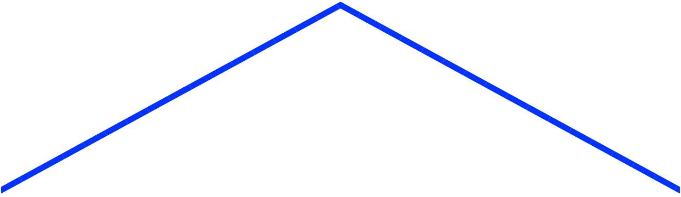
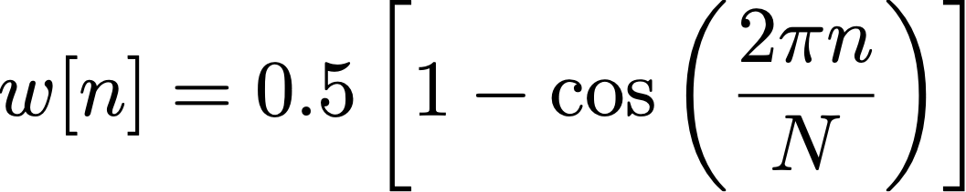
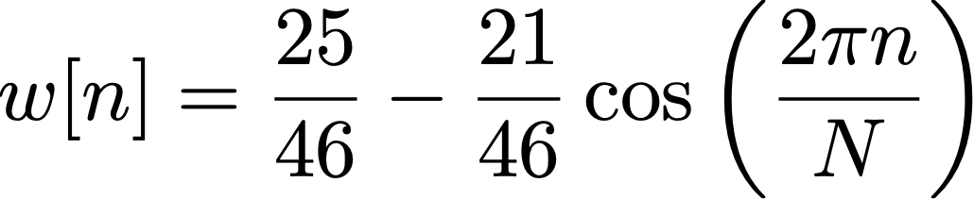
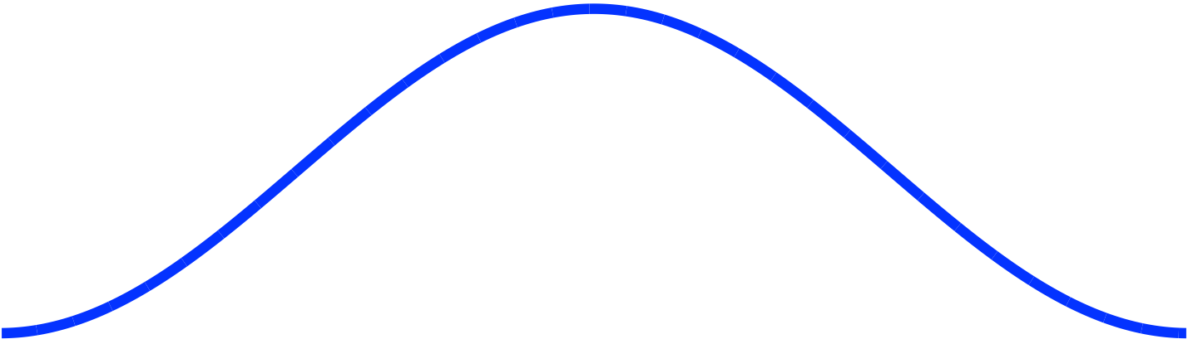
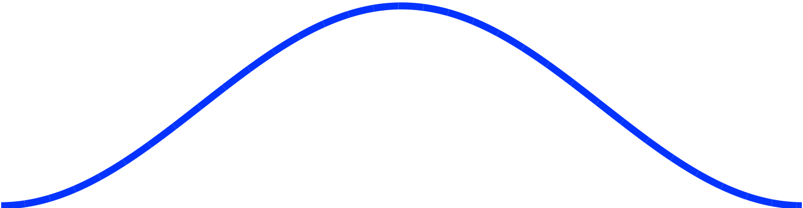
Types of window function
Rectangular
Triangular (Bartlett)
for
Hann
Hamming

Slide 13
Effect of rectangular window and Hann window applied to signal

Slide 14
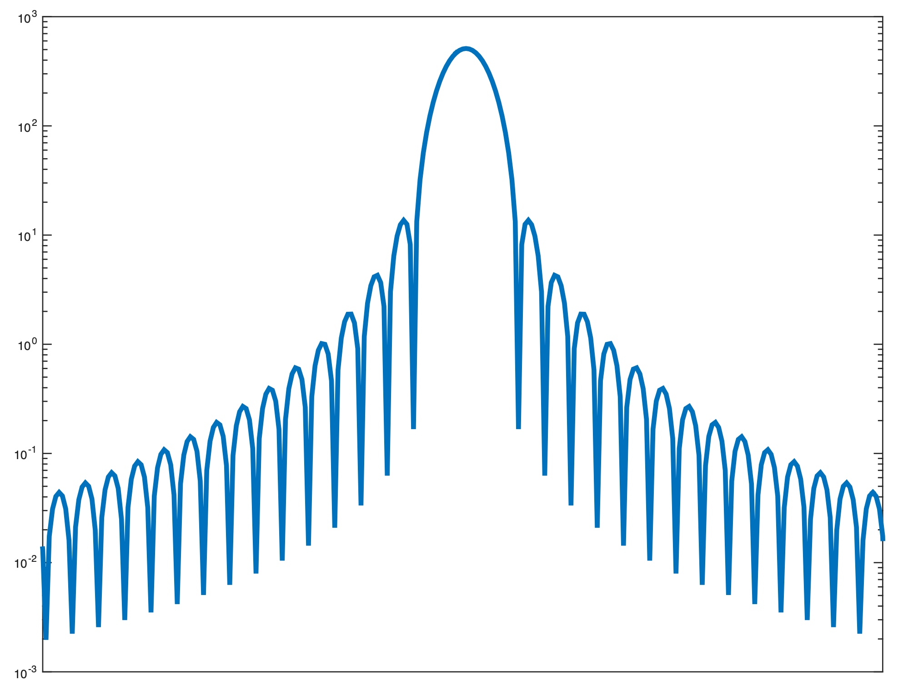
Window spectra
Windowing lets us isolate segment of signal
Cost is smearing of energy in frequency domain
Energy appears at frequencies where it doesn’t exist in original signal
Each frequency component of signal appears as series of lobes
Main lobe: broad peak centred around actual frequency
Side lobes: secondary peaks at other frequencies
Typically want to minimise:
Main lobe width
Side lobe height
Side lobe height
(expressed in dB)
Main lobe width
(expressed in
frequency)
Hann-windowed
spectrum
(frequency smearing)
ideal signal
(all energy at one
frequency)

Slide 15
Coding a window
Most efficient to pre-calculate window when program starts
Then recalculate when settings change: window size, window type etc.
Store window in an array (typically a global variable)
Array length equal to window size
To calculate, use for() loop to iterate over each sample of window
To apply, multiply signal by window buffer frame-by-frame
Could do this while unwrapping circular buffer
const int windowSize = 1024;
float windowBuffer[gWindowSize];
for (n = 0; n < windowSize; n++)
windowBuffer[n] =
equation for window
for(unsigned int n = 0; n < windowSize; n++) {
windowedSignal[n] = originalSignal[n] * windowBuffer[n];
}

